Slide 1

CS 334 Final Project
Spotify Hit Predictor
Can we predict if a song will be hit?
Jonathan, Anna, Mohammed

Slide 2

Problem Overview & Motivation
Is it possible to algorithmically determine whether a song will be a hit or not? What features of a song might be most indicative of a popular song?
Art is highly subjective; as such, it may be useful for music producers and record labels to get an objective metric of the work they promote.
Artists who want to make it big might want to see if their song is more likely to be a hit.
Notes:
Anna

Slide 3
Dataset
Features:
DANCEABILITY
LIVENESS
Over 40,000+ Tracks labeled hit or flop, with their features. Songs are separated by decade of release. Features (loudness, speechiness, etc.,) are objectively generated from audio of each song.
ENERGY
DURATION
KEY
SPEECHINESS
VALENCE
TEMPO
MODE
TIME SIGNATURE
Binary Categorical Targets: The target variable can be either 0 or 1. 1 implies that this song has featured in the weekly list (Issued by Billboards) of Hot-100 tracks in that decade at least once and is therefore a 'hit'. 0 Implies that the track is a 'flop'.
INSTRUMENTALNESS
CHORUS HIT
LOUDNESS
SECTIONS
ACOUSTICNESS
Notes:
What do the dataset/features look like?

Slide 4
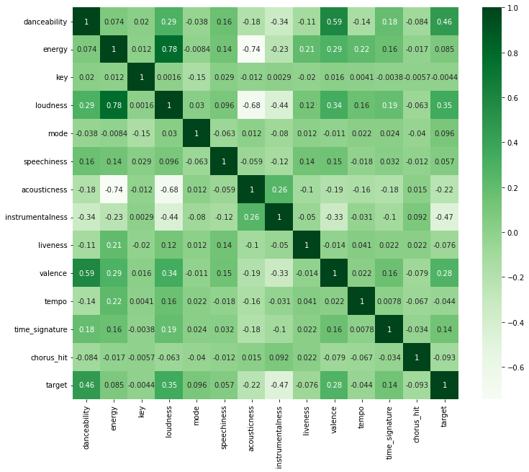
Preprocessing
Used a correlation matrix to determine which features in the dataset are highly correlated and should be removed.
Used Scikit’s StandardScaler to standardize the data
Notes:
What are the preprocessing, models, metrics and evaluation methodology?

Slide 5
Models & Evaluation
1st Fold
Ridge Classifier
Random Forest
Logistic Regression
Decision Tree
2nd Fold
3rd Fold
4th Fold
5th Fold
Validation Set
Training Set
Using K-Fold Cross Validation to validate whether our models are robust and perform well. GridSearchCV was also used to tune the hyperparameters.
Notes:
What are the preprocessing, models, metrics and evaluation methodology?

Slide 6
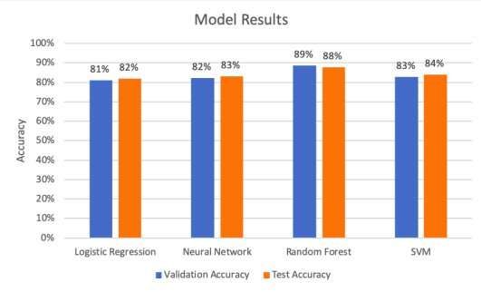
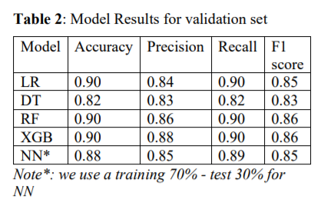
Existing Work
Using Spotify Data to Predict What Songs Will be Hits by:
Ingrid Fadelli , Tech Xplore
Predicting Afrobeats Hit Songs Using Spotify Data by:
Adewale Adeagbo
Notes:
What do the dataset/features look like? What are the preprocessing, models, metrics and evaluation methodology? How does it compare to existing work?

Slide 7
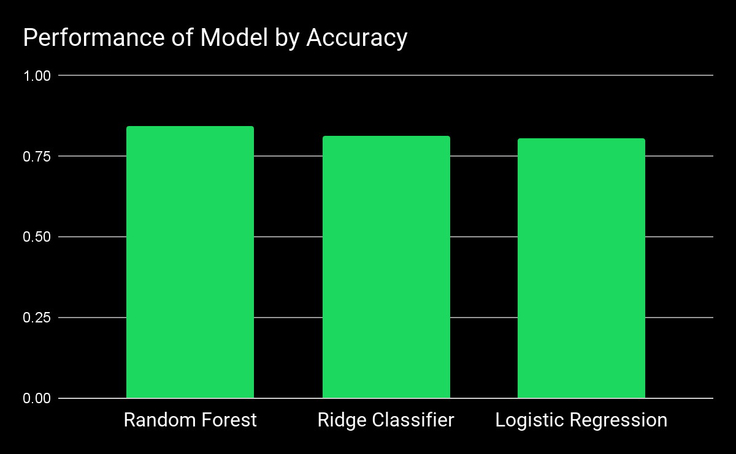
Preliminary Results
Hyperparameters found after tuning:
Ridge Classifier
Alpha:5
Fit_intercept: True
Random Forest
Still needs further optimization, OOB results needed
Logistic Regression:
C: 3
penalty: 'l2'
Notes:
What do the dataset/features look like? What are the preprocessing, models, metrics and evaluation methodology? How does it compare to existing work?

Slide 8
Thank You!
Jonathan, Anna, Mohammed

